Slide 1
Lead Score Case Study
Presented by : Dhanraj Babbar, Sanjeeta and Bidyut Kumar Roy

Slide 2
Lead Score Case Study for X Education
Problem :
One online X Education sells online courses to industry professionals. The company markets courses on variousal websites and search engines like Google, bing etc
when people land on the website, they might browse the courses or fill up a form for that course or may be watch videos. When these people fill up a form providing their email address or phone number, they are classified to be a lead. Moreover, the company also gets leads through past referrals.
Once these leads are acquired, employees from the sales team start making calls, writing emails, etc. Through this process, some of the leads get converted while most do not. The typical lead conversion rate at X education is around 30%.
Business Goal:
X Education needs help in selecting the most promising leads, i.e. the leads that are most likely to convert into paying customers.
The company needs a model wherein you a lead score is assigned to each of the leads such that the customers with higher lead score have a higher conversion chance and the customers with lower lead score have a lower conversion chance.
The CEO, in particular, has given a ballpark of the target lead conversion rate to be around 80%.

Slide 3
Strategies
Importing the packages and dataset
Clean junk data and prepare data
Analyzing the Variables.
Train and Test dataset.
Building a logistic Regression model and calculate Lead Score.
Evaluating the model by using different metrics – Accuracy, Sensitivity and specificacy.
Applying the best model in Test data based on the Sensitivity and Specificity Metrics.

Slide 4
Problem solving methodology
Data Sourcing , Cleaning and Preparation
Reading Data from Source
Converting data to clean format which is suitable for analysis
Remove duplicate data
Outlier
Analyzing the variables
Feature Standardization.
Feature Scaling and Splitting Train and Test Sets
Feature Scaling of Numeric
data
Splitting data into train and test set.
Model Building
Feature Selection using RFE
Determine the optimal model
using Logistic Regression
Calculate various metrics like accuracy, sensitivity, specificity, precision and recall and evaluate the model
Result
Determine the lead score and check if target final predictions amounts to 80% conversion rate.
Evaluate the final prediction on the test set using cut off threshold from sensitivity and specificity metrics

Slide 5
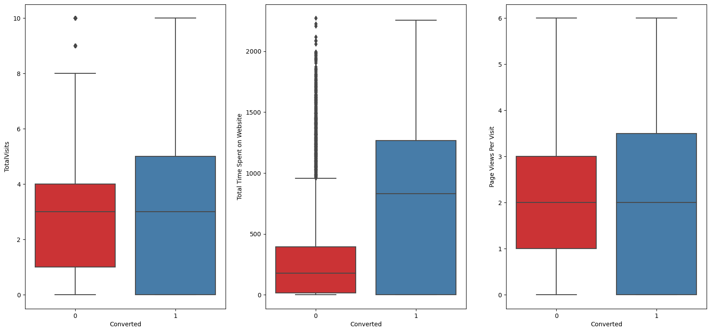
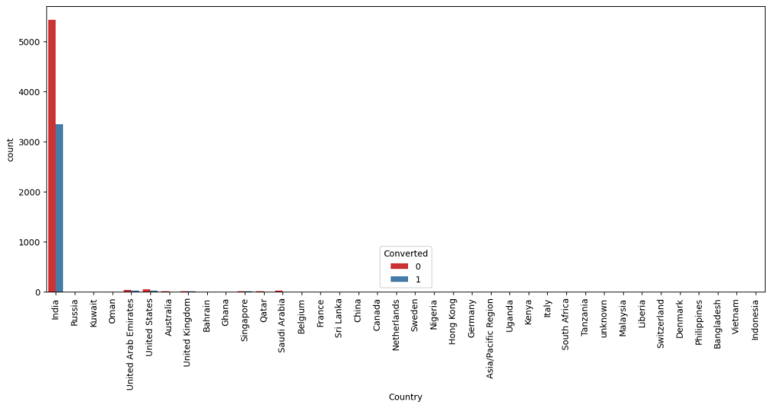
Exploratory Data Analysis
The conversion rates were high for Total Visits, Total Time Spent on Website and Page Views Per Visit
Conversion Chart showing below

Slide 6
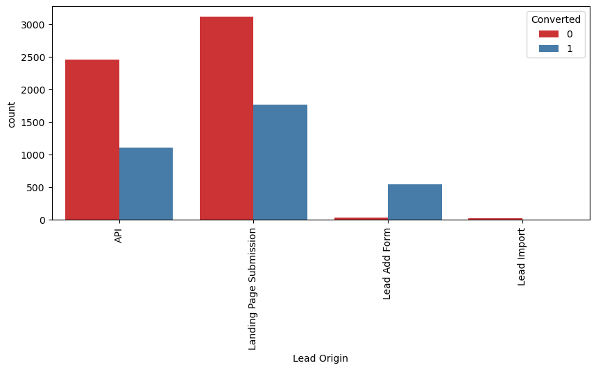
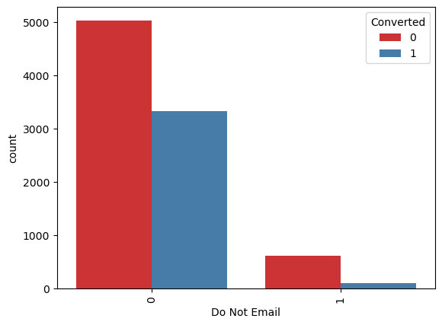
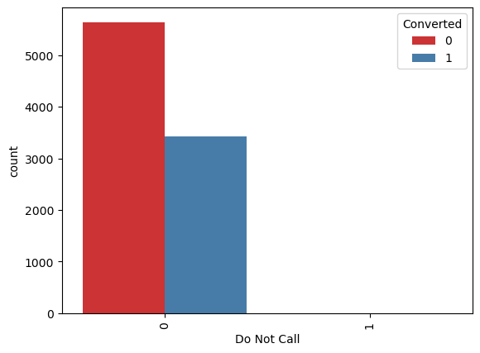
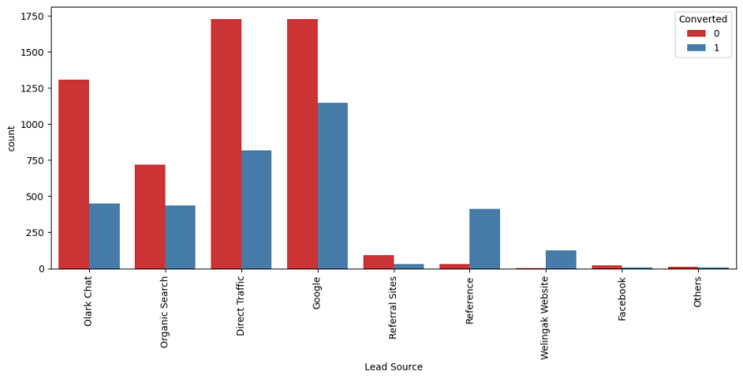
In Lead Origin, maximum conversion happened from Landing Page Submission
Major conversion has happened from Emails sent and Calls made
Major conversion in the lead source is from Google

Slide 7
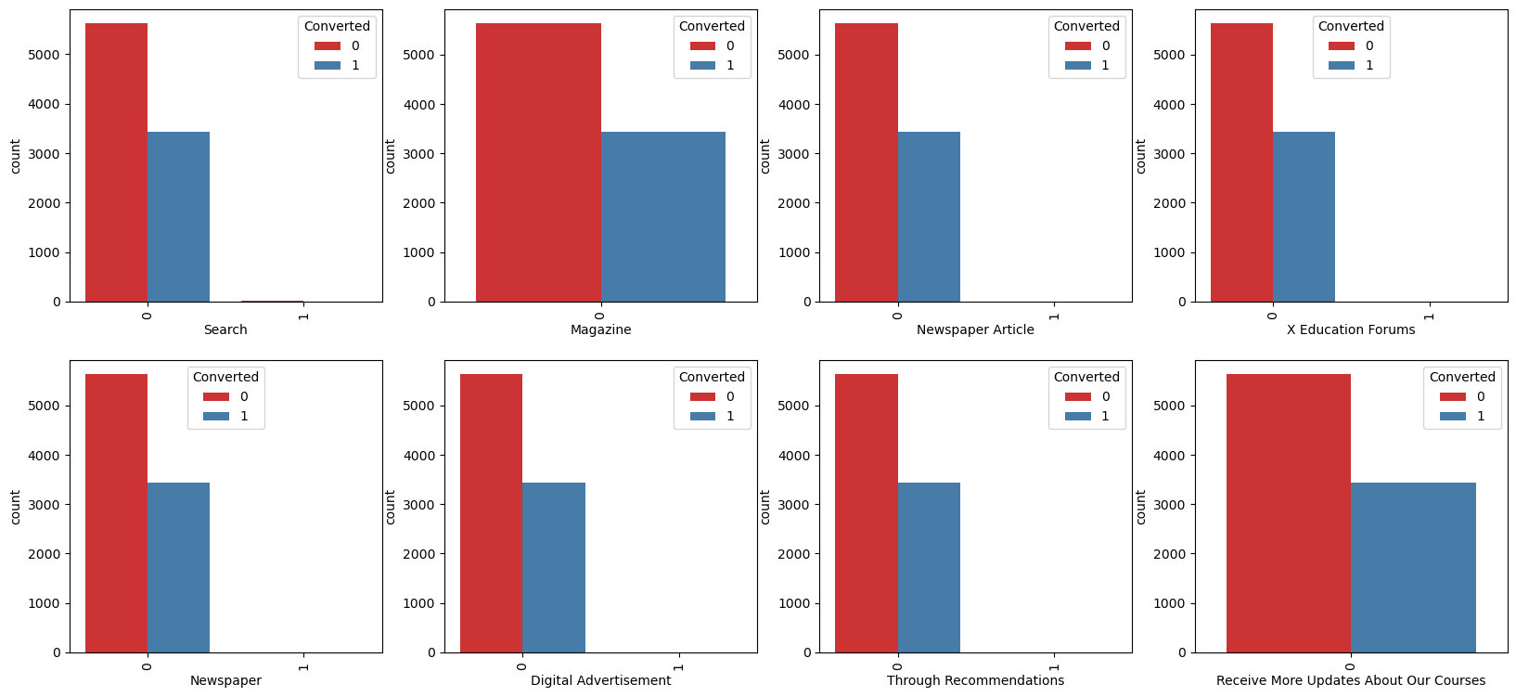
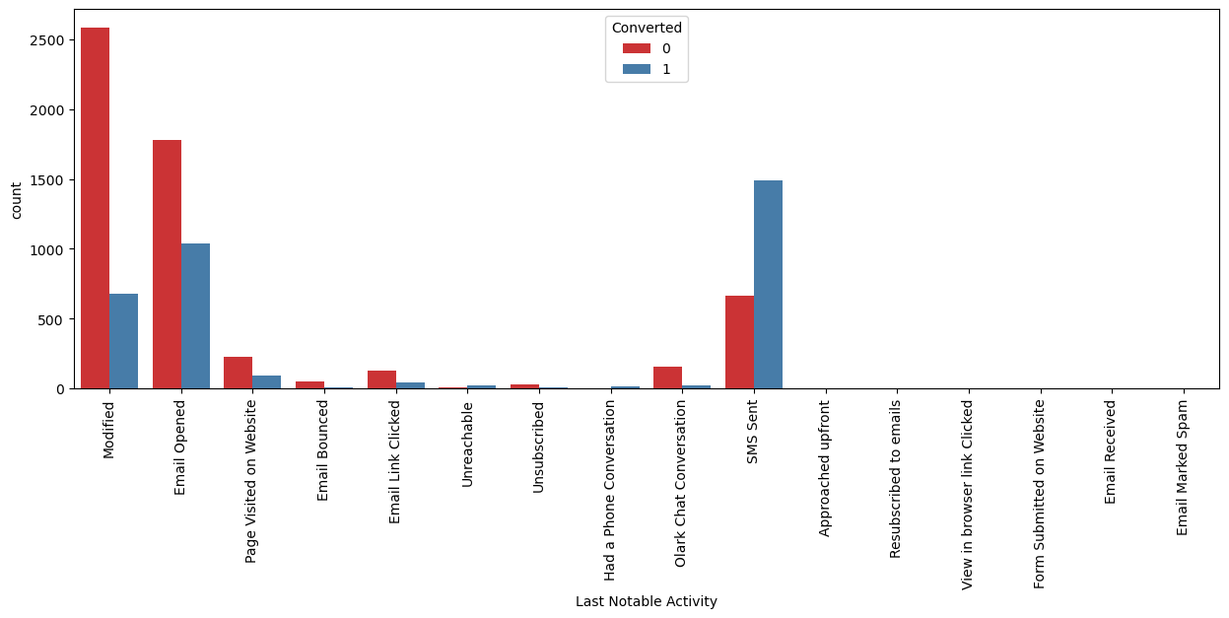
Not much impact on conversion rates through Search, digital advertisements and through recommendations
Last Activity value of SMS Sent' had more conversion.

Slide 8
Variables Impacting the Conversion Rate
Do Not Email
Total Visits
Total Time Spent On Website
Lead Origin – Lead Page Submission
Lead Origin – Lead Add Form
Lead Source - Olark Chat
Last Source – Welingak Website
Last Activity – Email Bounced
Last Activity – Not Sure
Last Activity – Olark Chat Conversation
Last Activity – SMS Sent
Current Occupation – No Information
Current Occupation – Working Professional
Last Notable Activity – Had a Phone Conversation
Last Notable Activity - Unreachable

Slide 9
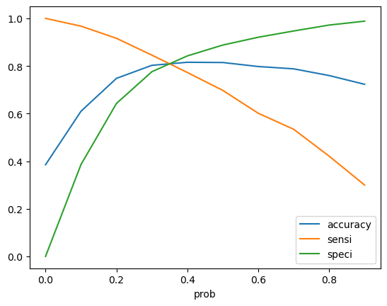
Model Evaluation - Sensitivity and Specificity on Train Data Set
Confusion Matrix
3467
438
740
1706
Accuracy - 81%
Sensitivity – 69 %
Specificity – 88 %
False Positive Rate - 11 %
Positive Predictive Value - 79 %
Positive Predictive Value – 82%
Precision - 79 %
Recall - 69 %

Slide 10
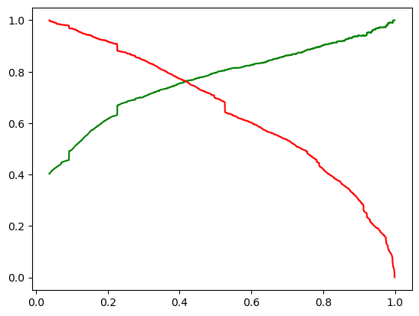
Model Evaluation- Precision and Recall on Train Dataset
The graph depicts an optimal cut off of 0.42 based on Precision and
Recall
Confusion Matrix
1395
339
192
797

Slide 11
Model Evaluation – Sensitivity and Specificity on Test Dataset
Confusion Matrix
1395
339
1394 300
192
797
218
79
Accuracy – 80.4 %
Sensitivity – 80.50 %
Specificity – 80.40 %

